Slide 1
Clients Served by the Ryan White HIV/AIDS Program 2021
Overview
Released February 2023
Notes:
HRSA is on four social media platforms. We encourage you to follow along and share our content on Twitter, Facebook, LinkedIn and Instagram to stay up-to-date on the latest HRSA news. Our account/handle on each platform is @HRSAgov.
Additionally, we also encourage you to sign up for HRSA’s e-News, a biweekly email of comprehensive HRSA news, and to sign up for HRSA press releases. You can also visit our website www.HRSA.gov for more detailed information about all of our programs.

Slide 2
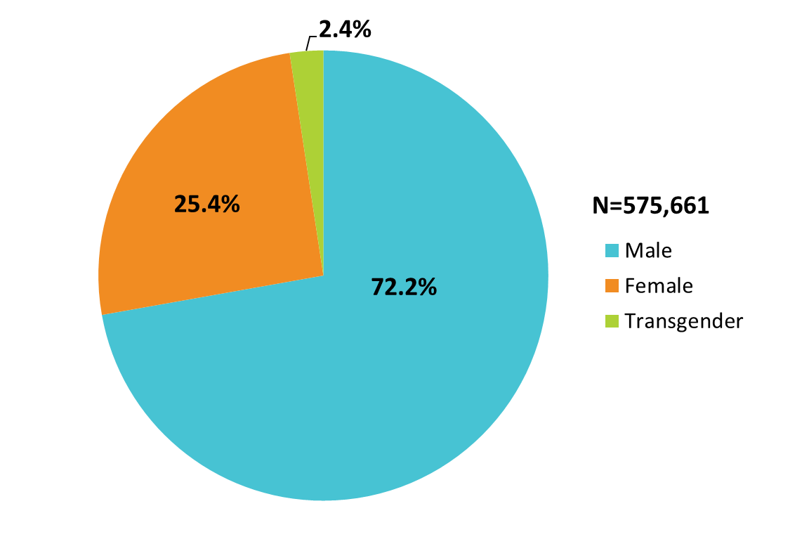
Clients Served by the Ryan White HIV/AIDS Program, by Gender, 2021 — United States and 3 Territoriesª
ª Guam, Puerto Rico, and the U.S. Virgin Islands.
Notes:
The RWHAP serves over half a million people each year. In 2021, of the 575,661 clients with a reported gender, 72.2% were male, 25.4% were female, and 2.4% were transgender.
The three territories include Guam, Puerto Rico, and the U.S. Virgin Islands.

Slide 3
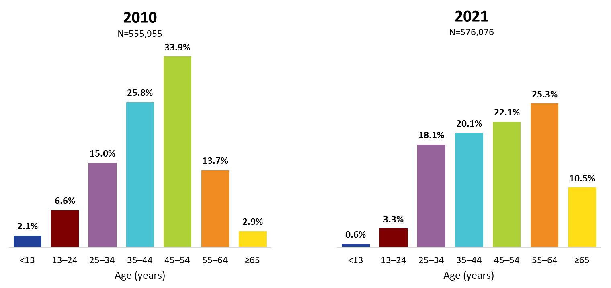
Ryan White HIV/AIDS Program Clients, by Age Group, 2010 and 2021—United States and 3 Territoriesª
ª Guam, Puerto Rico, and the U.S. Virgin Islands.
Notes:
The age distribution is shifting among RWHAP clients. From 2010 through 2021, the percentage of clients aged 35–54 years decreased (combined, 59.7% of the RWHAP population was aged 35–54 in 2010, decreasing to 42.2% in 2021), while the percentage increased during this time for those aged 55 and older (combined, from 16.6% in 2010 to 35.8% in 2021). Clients aged 65 years and older accounted for 10.5% of all clients in 2021, but nearly one-third (29.4%) of clients aged 55 and older.
The three territories include Guam, Puerto Rico, and the U.S. Virgin Islands.

Slide 4
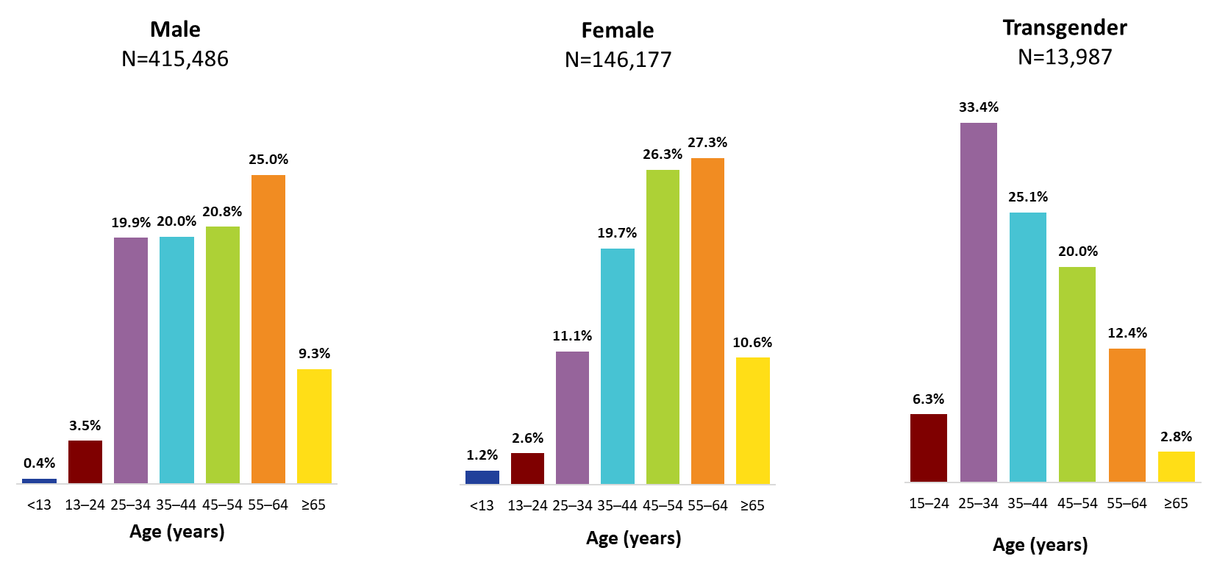
Clients Served by the Ryan White HIV/AIDS Program, by Gender and Age Group, 2021—United States and 3 Territoriesª
ª Guam, Puerto Rico, and the U.S. Virgin Islands.
To ensure confidentiality, data have been suppressed for transgender clients aged less than 15 years.
Notes:
In 2021, among male clients, 45.8% were aged 45–64 years (20.8% aged 45–54 years and 25.0% aged 54–64 years).
Among female clients, 53.6% were aged 45–64 years (26.3% aged 45–54 years and 27.3% aged 55–64 years).
Transgender clients were younger than male and female clients; 58.5% were aged 25–44 years (33.4% aged 25–34 and 25.1% aged 35–44 years).
The three territories include Guam, Puerto Rico, and the U.S. Virgin Islands.
To ensure confidentiality, data were suppressed for transgender clients aged less than 15 years.
Due to rounding, percentages may not sum to 100.0%.

Slide 5
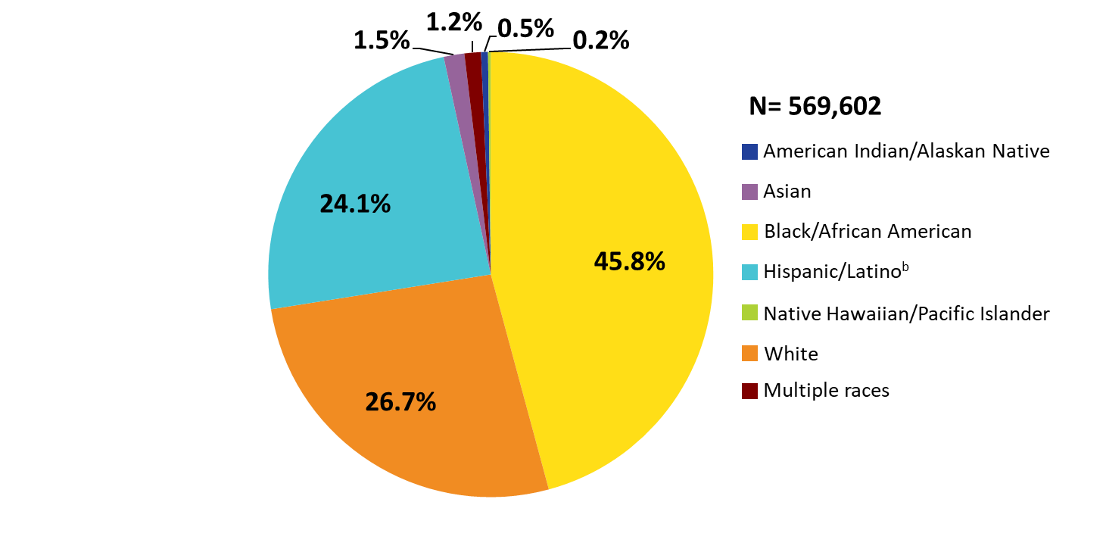
Clients Served by the Ryan White HIV/AIDS Program, by Race/Ethnicity, 2021—United States and 3 Territoriesª
ª Guam, Puerto Rico, and the U.S. Virgin Islands.
^{b} Hispanics/Latinos can be of any race.
Notes:
Nearly three-quarters (73.3%) of RWHAP clients are from racial/ethnic minority populations. In 2021, of the 569,602 clients with reported race/ethnicity information, 45.8% self-identified as Black/African American, 24.1% Hispanic/Latino, and less than 3.5% each American Indian/Alaska Native, Asian, Native Hawaiian/Pacific Islander, and people of multiple races. Whites accounted for 26.7% of clients. The percentage distribution has remained consistent since 2010.
Hispanics/Latinos can be of any race.
The three territories include Guam, Puerto Rico, and the U.S. Virgin Islands.

Slide 6
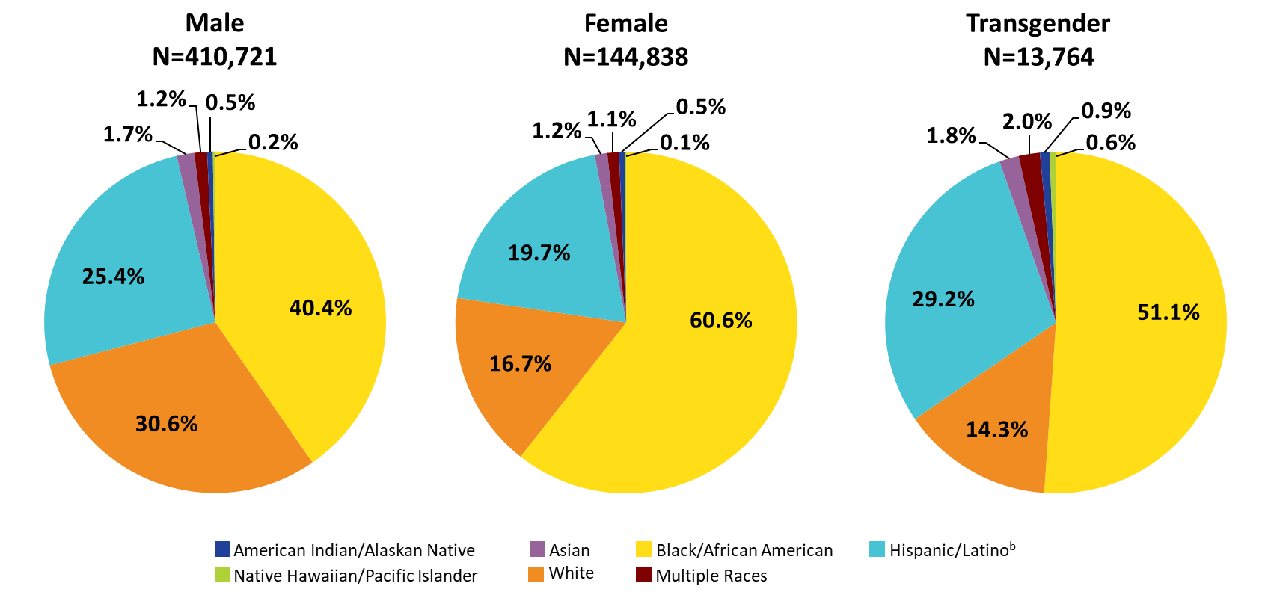
Clients Served by the Ryan White HIV/AIDS Program, by Gender and Race/Ethnicity, 2021—United States and 3 Territoriesª
ª Guam, Puerto Rico, and the U.S. Virgin Islands.
^{b} Hispanics/Latinos can be of any race.
Notes:
In 2021, 69.4% of male clients, 83.3% of female clients, and 85.7% of transgender clients were racial/ethnic minorities. For reference, white clients appear in each pie chart in orange shading.
Hispanics/Latinos can be of any race.
The three territories include Guam, Puerto Rico, and the U.S. Virgin Islands.

Slide 7
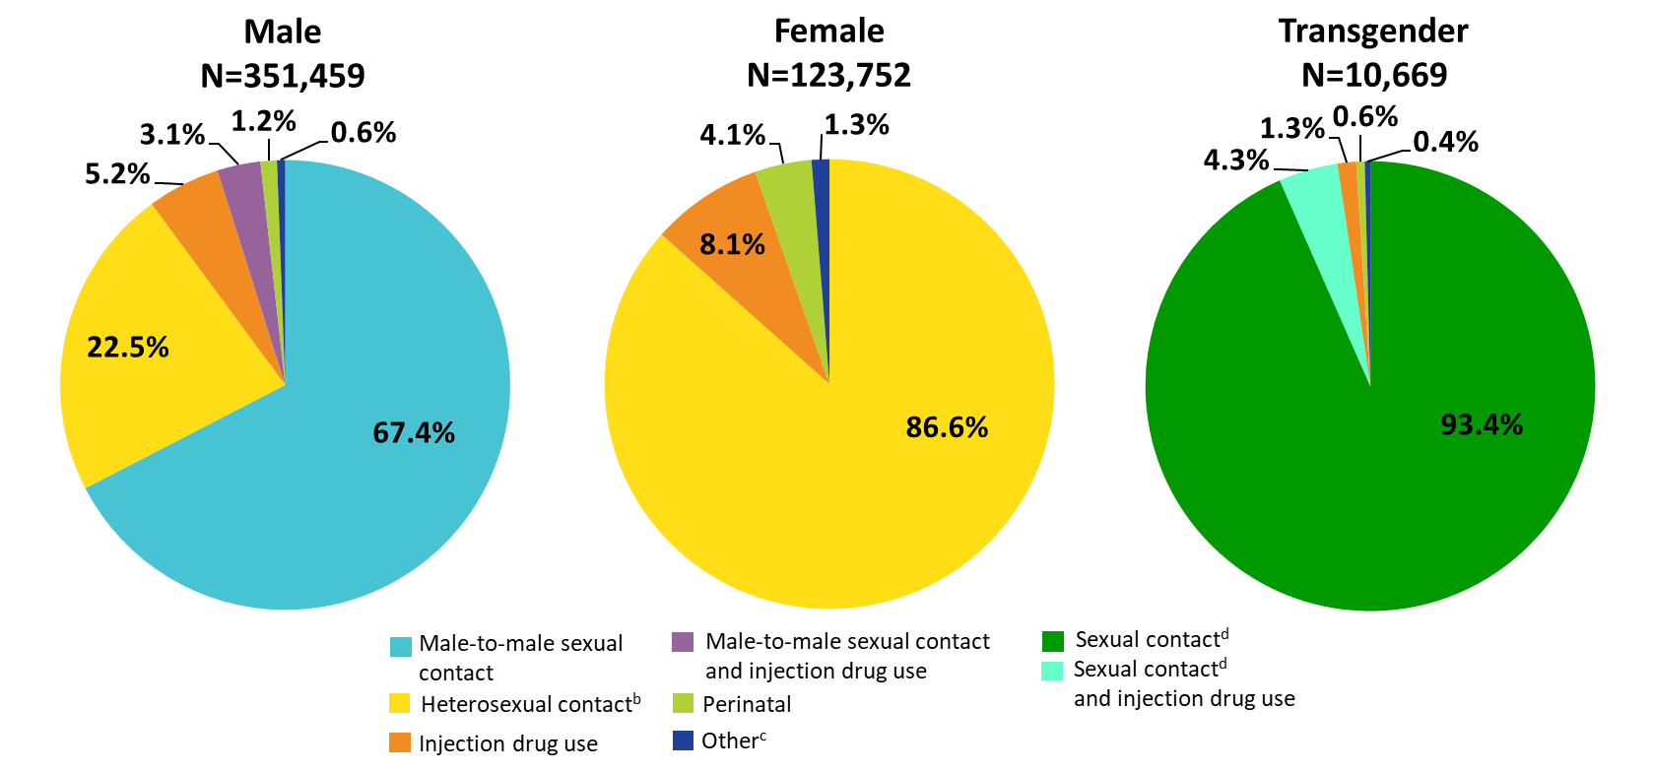
Clients Served by the Ryan White HIV/AIDS Program by Gender and Transmission Category, 2021—United States and 3 Territoriesª
ª Guam, Puerto Rico, and the U.S. Virgin Islands.
^{b} Heterosexual contact with a person know to have, or be at high risk for, HIV.
^{c} Includes hemophilia and blood transfusion.
^{d} Includes any reported sexual transmission category.
Notes:
By gender and transmission category, among male clients, 67.4% had HIV attributed to male-to-male sexual contact; 22.5% had HIV attributed to heterosexual contact; 5.2% to injection drug use; 3.1% to male-to-male sexual contact and injection drug use; and 1.2% to perinatal acquisition.
Among female clients, 86.6% had HIV attributed to heterosexual contact; 8.1% to injection drug use, and 4.1% to perinatal acquisition.
Among transgender clients, 93.4% had HIV attributed to some form of sexual contact, 4.3% to sexual contact and injection drug use, and 1.3% to injection drug use.
Heterosexual contact includes specific heterosexual contact with a person known to have, or to be at high risk for, HIV.
Other includes hemophilia, blood transfusion, and unknown risk factor.
Sexual contact includes any reported sexual transmission risk category for transgender clients.
The three territories include Guam, Puerto Rico, and the U.S. Virgin Islands.

Slide 8
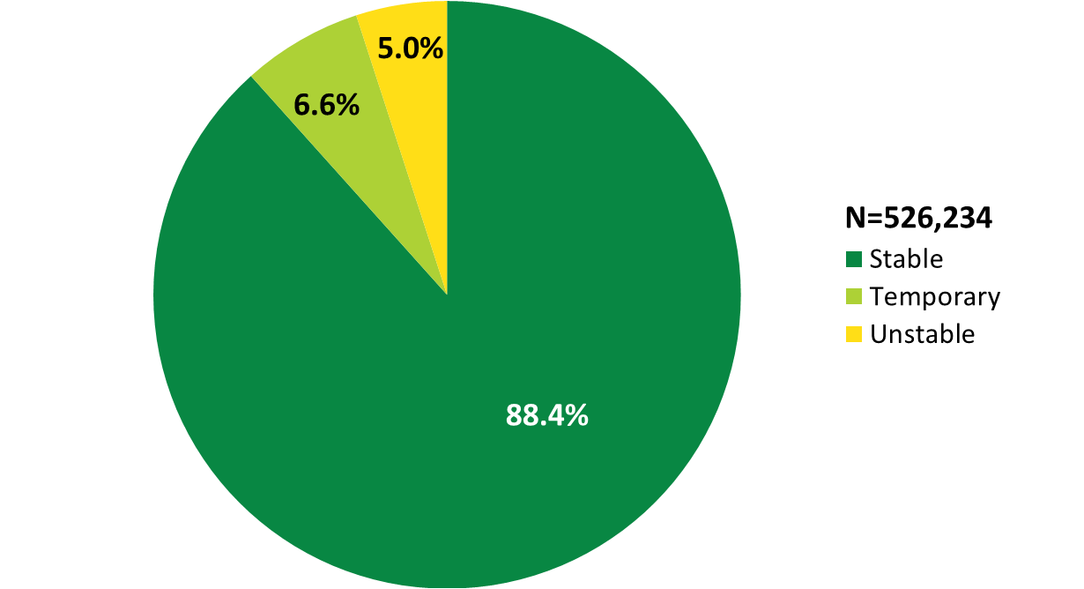
Clients Served by the Ryan White HIV/AIDS Program, by Housing Status, 2021—United States and 3 Territoriesª
ª Guam, Puerto Rico, and the U.S. Virgin Islands.
Notes:
In 2021, of the 526,234 clients with reported housing status, 6.6% had temporary housing and 5.0% had unstable housing.
The three territories include Guam, Puerto Rico, and the U.S. Virgin Islands.

Slide 9
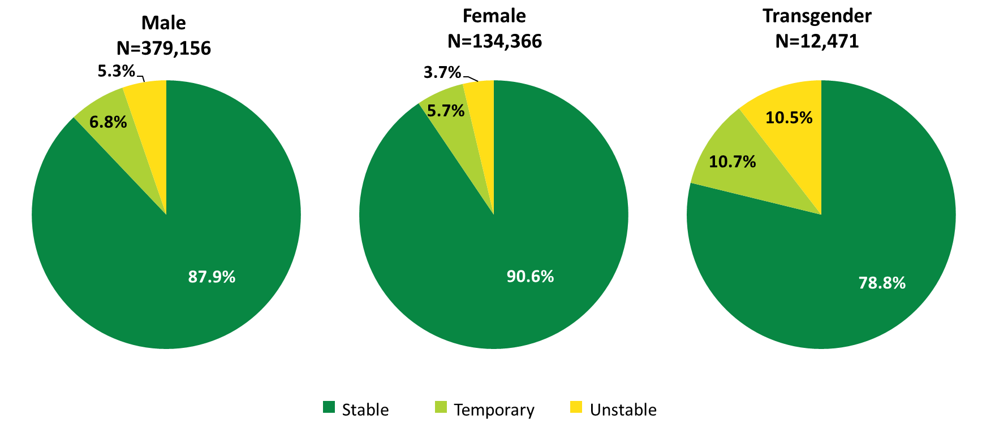
Clients Served by the Ryan White HIV/AIDS Program, by Gender and Housing Status, 2021—United States and 3 Territoriesª
ª Guam, Puerto Rico, and the U.S. Virgin Islands.
Notes:
A greater proportion of female RWHAP clients had stable housing in 2021, compared with male and transgender clients. Among female RWHAP clients, 5.7% had temporary housing and 3.7% had unstable housing. Among male clients, 6.8% had temporary housing and 5.3% had unstable housing. Among transgender clients, more than one-fifth of clients did not have stable housing: 10.7% had temporary housing and 10.5% had unstable housing.
The three territories include Guam, Puerto Rico, and the U.S. Virgin Islands.

Slide 10
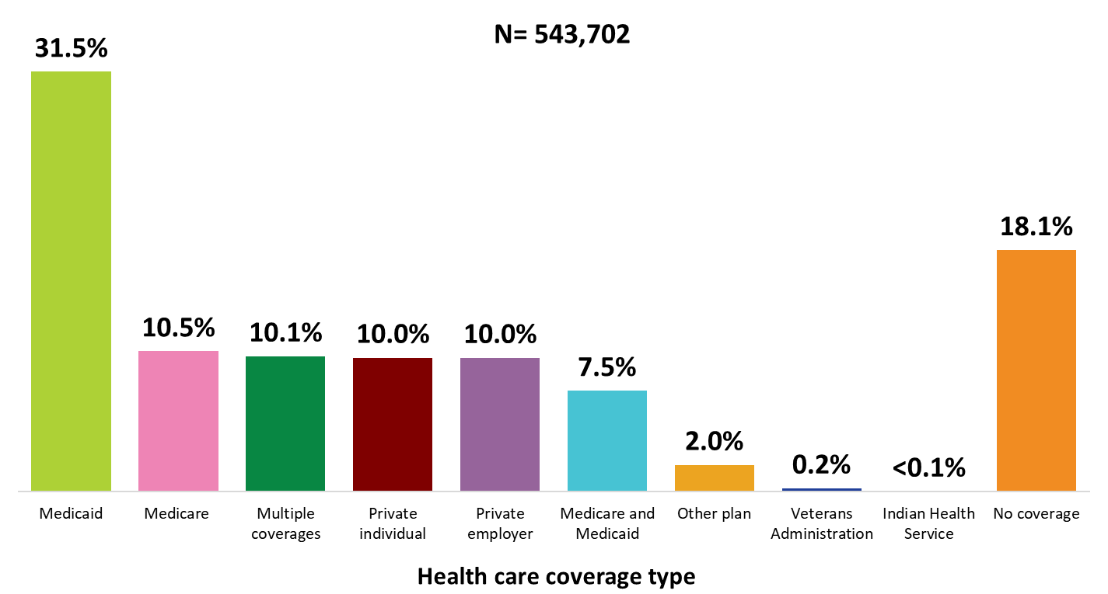
Clients Served by the Ryan White HIV/AIDS Program, by Health Care Coverage, 2021—United States and 3 Territoriesª
ª Guam, Puerto Rico, and the U.S. Virgin Islands.
Notes:
In 2021, 81.9% of RWHAP clients had some form of health care coverage. Of the 543,702 clients with reported health care coverage information, 31.5% were covered by Medicaid, 10.5% were covered by Medicare, 10.1% had multiple forms of coverage, 10.0% had private employer coverage, 10.0% had private individual coverage, and 7.5% had both Medicare and Medicaid dual coverage. Nearly one-fifth (18.1%) of RWHAP clients had no health care coverage in 2021.
Multiple coverage includes any combination of coverage types except for the Medicare and Medicaid dual enrollment category, which is displayed separately.
The three territories include Guam, Puerto Rico, and the U.S. Virgin Islands.

Slide 11
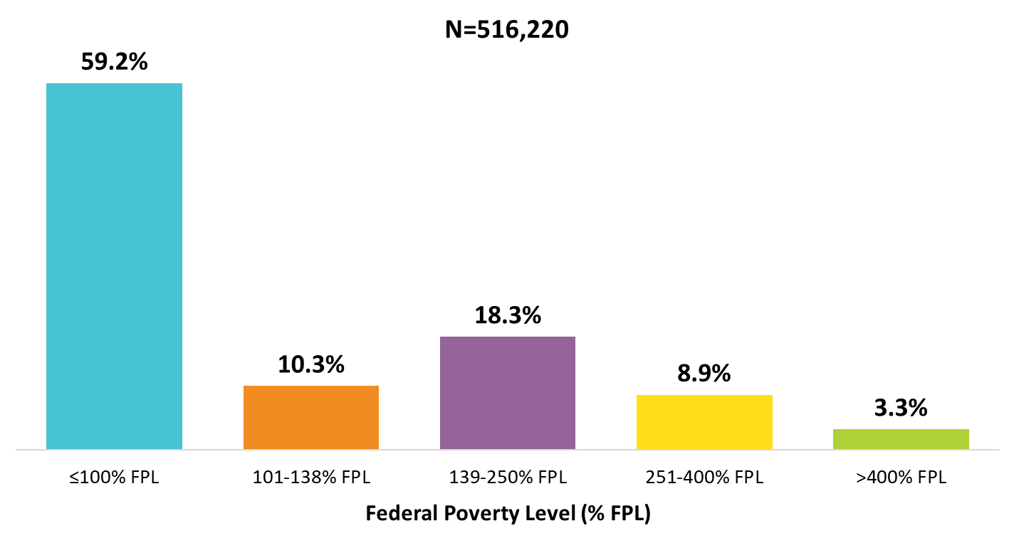
Clients Served by the Ryan White HIV/AIDS Program, by Poverty Level, 2021—United States and 3 Territoriesª
ª Guam, Puerto Rico, and the U.S. Virgin Islands.
Notes:
In 2021, 59.2% of the 516,220 clients with income information were living at or below 100% of the federal poverty level (FPL).
The three territories include Guam, Puerto Rico, and the U.S. Virgin Islands.

Slide 12
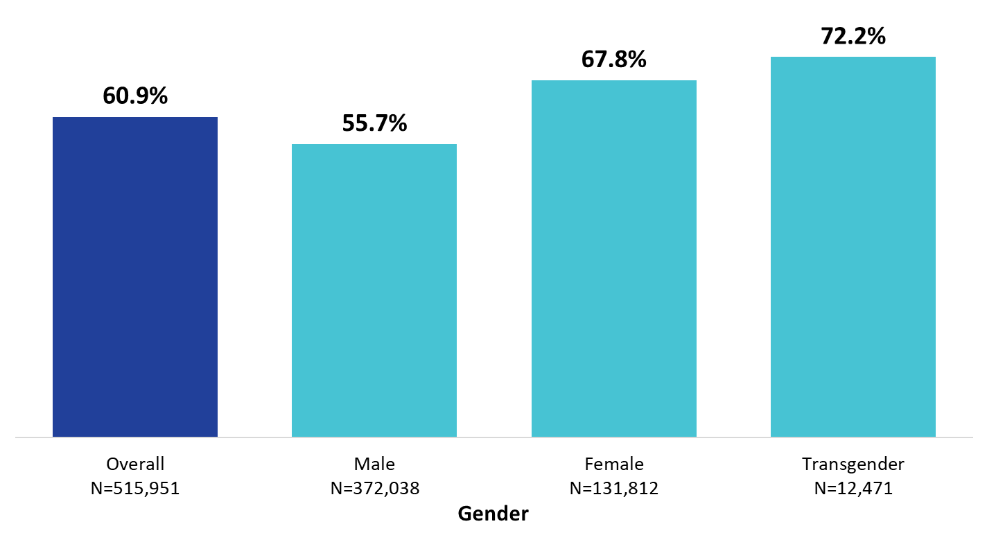
Clients Served by the Ryan White HIV/AIDS Program Living ≤100% of the Federal Poverty Level, by Gender, 2021—United States and 3 Territoriesª
ª Guam, Puerto Rico, and the U.S. Virgin Islands.
Notes:
Female and transgender clients had lower incomes than male clients. Among the 131,812 female clients with poverty level information in 2021, 67.8% were living at or below 100% of the federal poverty level (FPL). Among the 12,471 transgender clients with poverty level information, 72.2% were living at or below 100% FPL. These percentages are compared to 55.7% of male clients and the average across all RWHAP clients of 60.9%.
The three territories include Guam, Puerto Rico, and the U.S. Virgin Islands.

Slide 13
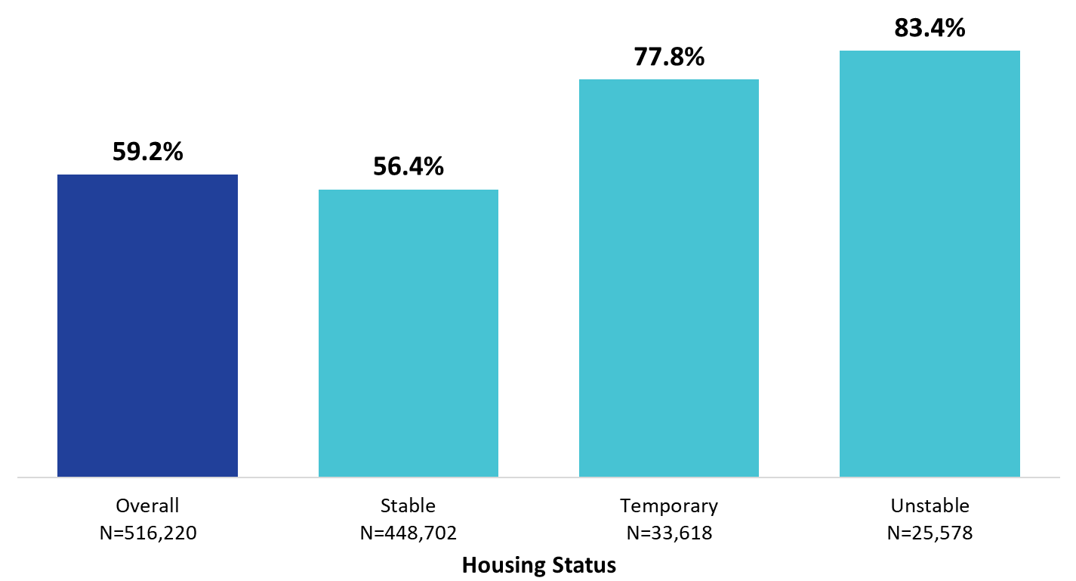
Clients Served by the Ryan White HIV/AIDS Program Living ≤100% of the Federal Poverty Level, by Housing Status, 2021—United States and 3 Territoriesª
ª Guam, Puerto Rico, and the U.S. Virgin Islands.
Notes:
Among clients with stable housing who had reported poverty level information in 2021, 56.4% were living ≤100% FPL. Among clients with temporary housing, 77.8% were living ≤100% FPL. Among clients with unstable housing, 83.7% were living ≤100% FPL.
The three territories include Guam, Puerto Rico, and the U.S. Virgin Islands.

