Slide 1
Clients Served by the Ryan White HIV/AIDS Program, 2021
Transgender Clients
Released February 2023
Notes:
HRSA is on four social media platforms. We encourage you to follow along and share our content on Twitter, Facebook, LinkedIn and Instagram to stay up-to-date on the latest HRSA news. Our account/handle on each platform is @HRSAgov.
Additionally, we also encourage you to sign up for HRSA’s e-News, a biweekly email of comprehensive HRSA news, and to sign up for HRSA press releases. You can also visit our website www.HRSA.gov for more detailed information about all of our programs.

Slide 2
Demographic Characteristics
Transgender Clients

Slide 3
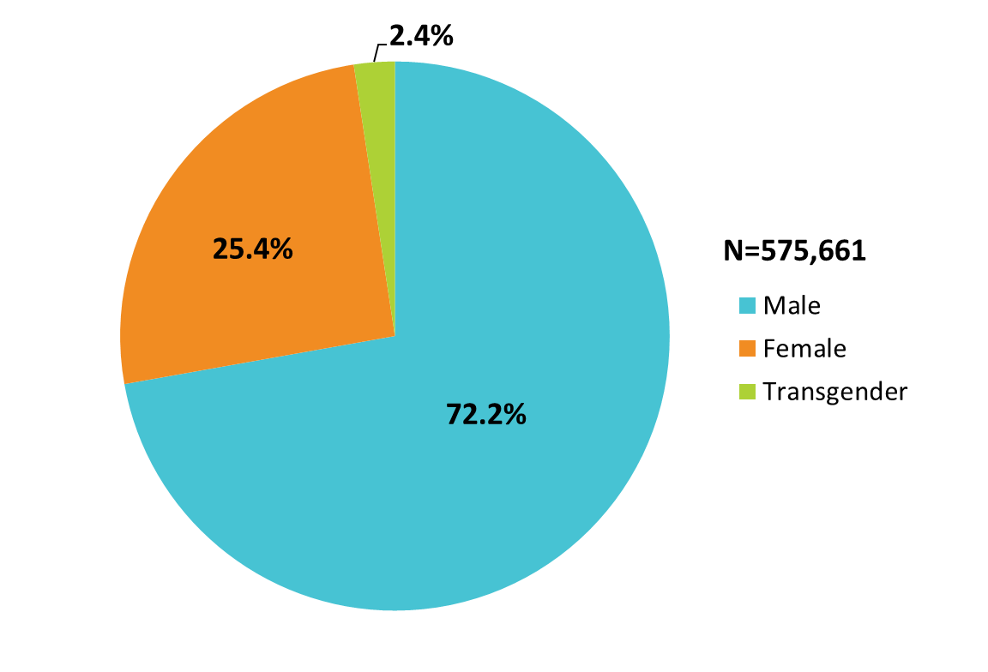
Clients Served by the Ryan White HIV/AIDS Program, by Gender, 2021 — United States and 3 Territoriesª
ª Guam, Puerto Rico, and the U.S. Virgin Islands.
Notes:
The RWHAP serves over half a million people each year. In 2021, of the 575,661 clients with a reported gender, 72.2% were male, 25.4% were female, and 2.4% were transgender.
The three territories include Guam, Puerto Rico, and the U.S. Virgin Islands.

Slide 4
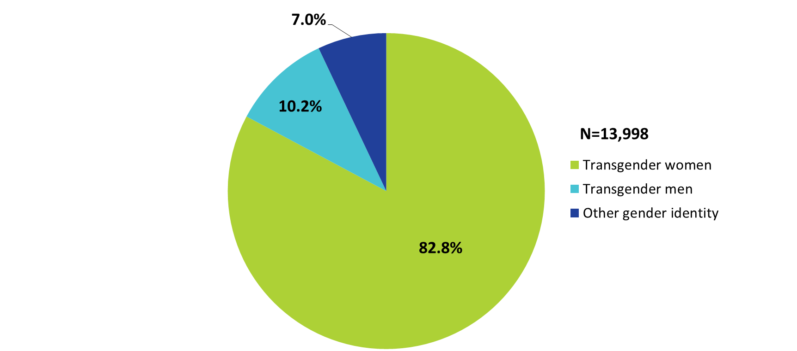
Transgender Clients Served by the Ryan White HIV/AIDS Program, by Gender Identity, 2021—United States and 3 Territoriesª
ª Guam, Puerto Rico, and the U.S. Virgin Islands.
Notes:
In 2021, 82.8% of transgender RWHAP clients were transgender women. Another 10.2% were transgender men and 7.0% had another gender identity.
The three territories are Guam, Puerto Rico, and the U.S. Virgin Islands.

Slide 5
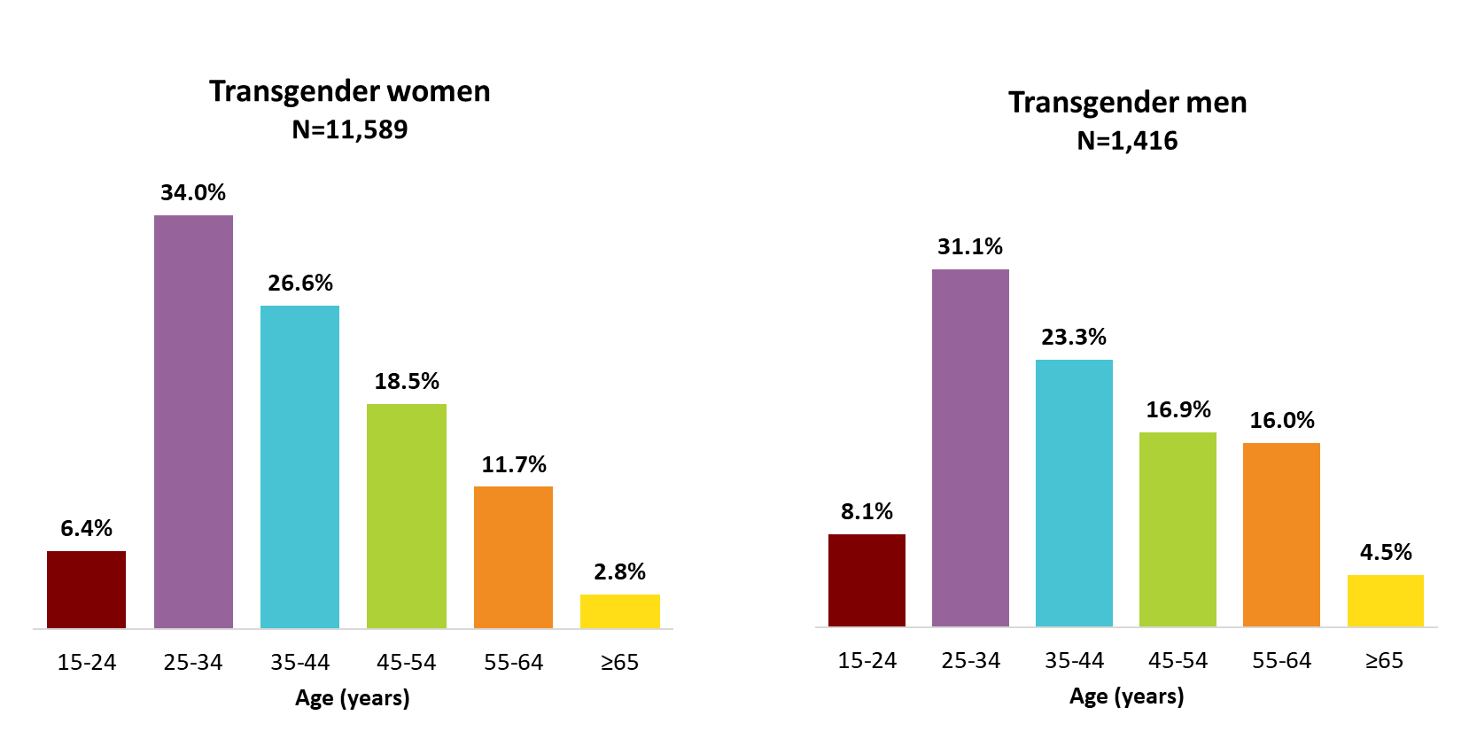
Transgender Clients Aged 15 Years and Older Served by the Ryan White HIV/AIDS Program, by Gender Identity and Age Group, 2021—United States and 3 Territoriesª
To ensure confidentiality, data have been suppressed for transgender clients aged less than 15 years.
Clients with other gender identities are not presented due to small numbers.
ª Guam, Puerto Rico, and the U.S. Virgin Islands.
Notes:
Among transgender RWHAP clients, 34.0% of transgender women and 31.1% of transgender men were aged 25–34 years in 2021. Almost half (45.1%) of transgender women and 40.2% of transgender men were aged 35–54 years.
The three territories are Guam, Puerto Rico, and the U.S. Virgin Islands.
To ensure confidentiality, data for transgender youth aged 13–14 years are not presented.

Slide 6
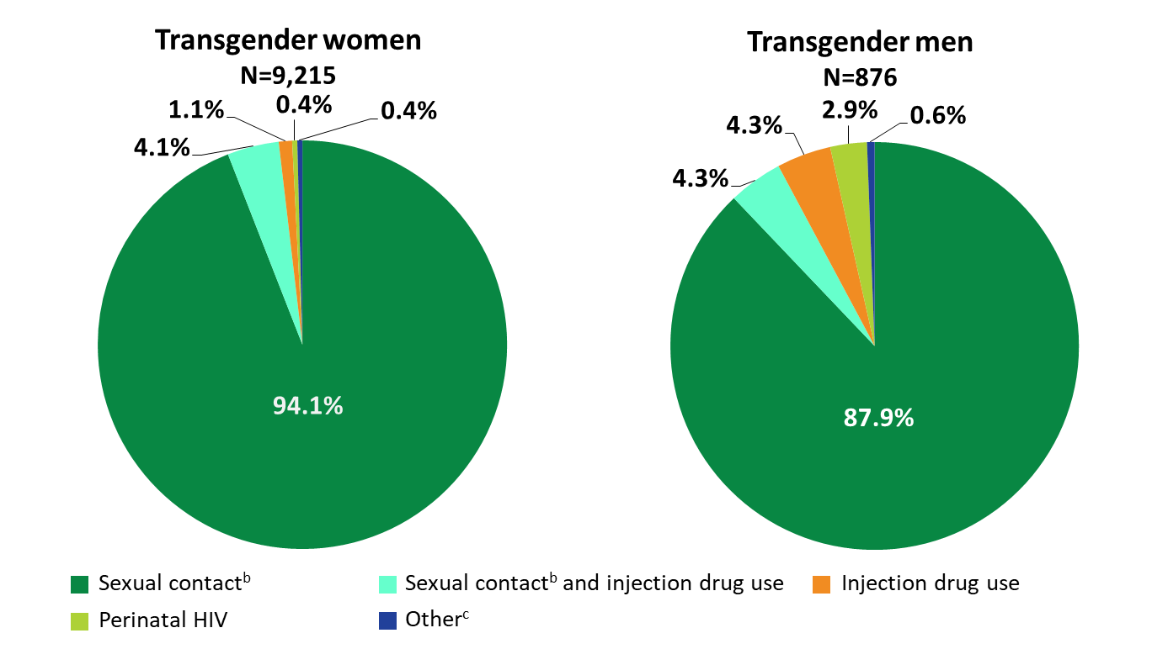
Transgender Clients Aged 15 Years and Older Served by the Ryan White HIV/AIDS Program, by Gender Identity and Transmission Category, 2021—United States and 3 Territoriesª
Clients with other gender identities are not presented due to small numbers
ª Guam, Puerto Rico, and the U.S. Virgin Islands.
^{b} Includes any reported sexual transmission risk category.
^{c} Includes hemophilia and blood transfusion.
Notes:
Among the 9,215 transgender women served by RWHAP with transmission information in 2021, 94.1% had HIV infection attributed to sexual contact, 4.1% to sexual contact and injection drug use, 1.1% to injection drug use, and less than 1% each to perinatally acquired infection and to other transmission categories.
Among the 876 transgender men, 87.9% had HIV infection attributed to sexual contact, 4.3% to sexual contact and injection drug use, 2.9% to perinatally acquired infection, 4.3% to injection drug use, and less than 1% to other transmission categories.
The three territories are Guam, Puerto Rico, and the U.S. Virgin Islands.
Sexual contact includes any reported sexual transmission risk category.
Other includes hemophilia and blood transfusion.

Slide 7
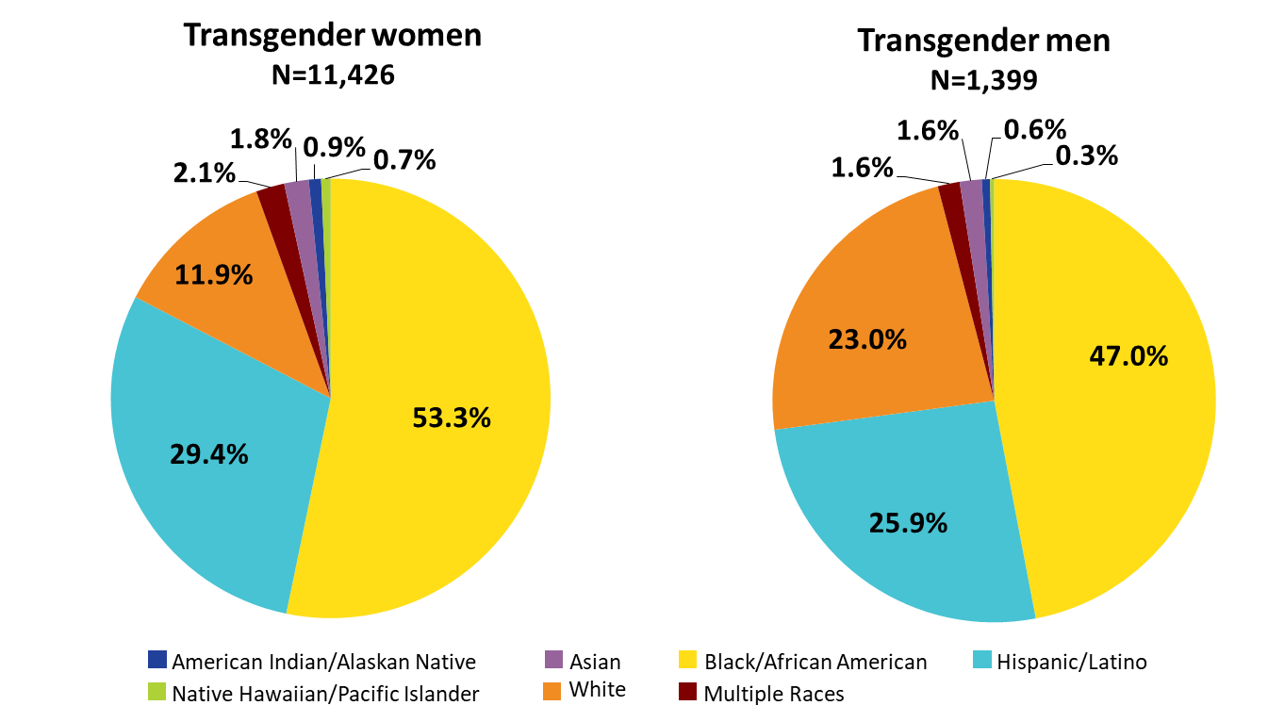
Transgender Clients Served by the Ryan White HIV/AIDS Program, by Gender Identity and Race/Ethnicity, 2021—United States and 3 Territoriesª
Clients with other gender identities are not presented due to small numbers.
Hispanics/Latinos can be of any race.
ª Guam, Puerto Rico, and the U.S. Virgin Islands.
Notes:
Among the 11,426 transgender women served by RWHAP with reported race/ethnicity information, 88.1% were from racial/ethnic minority populations: 53.3% were Black/African American; 29.4% Hispanic/Latino; less than 3% each American Indian/Alaska Native, Asian, Native Hawaiian/Pacific Islander, and multiple races. Whites accounted for 11.9% of clients.
Among the 1,399 transgender men served by RWHAP with reported race/ethnicity information, 77.0% were from racial/ethnic minority populations: 47.0 % were Black/African American; 25.9% Hispanic/Latino; and less than 2% each American Indian/Alaska Native, Asian, Native Hawaiian/Pacific Islander, and multiple races. Whites accounted for 23.0% of clients.
Hispanics/Latinos can be of any race.
The three territories are Guam, Puerto Rico, and the U.S. Virgin Islands.

Slide 8
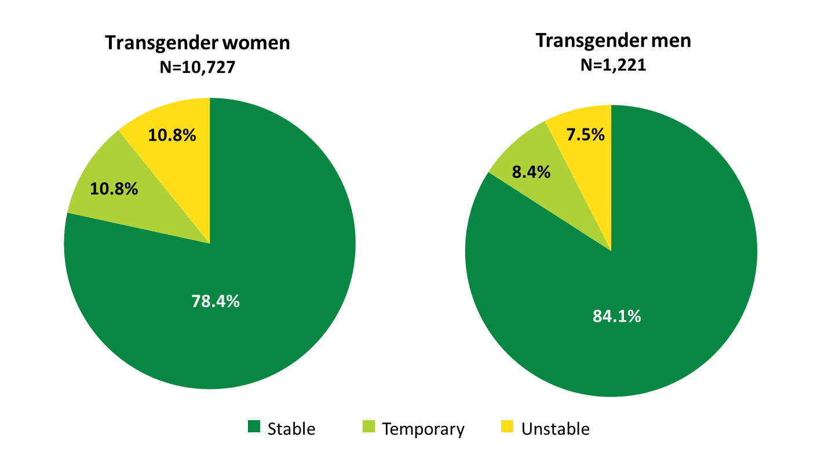
Transgender Clients Served by the Ryan White HIV/AIDS Program, by Gender Identity and Housing Status, 2021—United States and 3 Territoriesª
Clients with other gender identities are not presented due to small numbers.
ª Guam, Puerto Rico, and the U.S. Virgin Islands.
Notes:
Among 10,727 transgender women served by RWHAP with housing information, 10.8% had temporary housing and 10.8% had unstable housing in 2021. Among 1,221 transgender men, 8.4% had temporary housing and 7.5% had unstable housing.
The three territories are Guam, Puerto Rico, and the U.S. Virgin Islands.

Slide 9
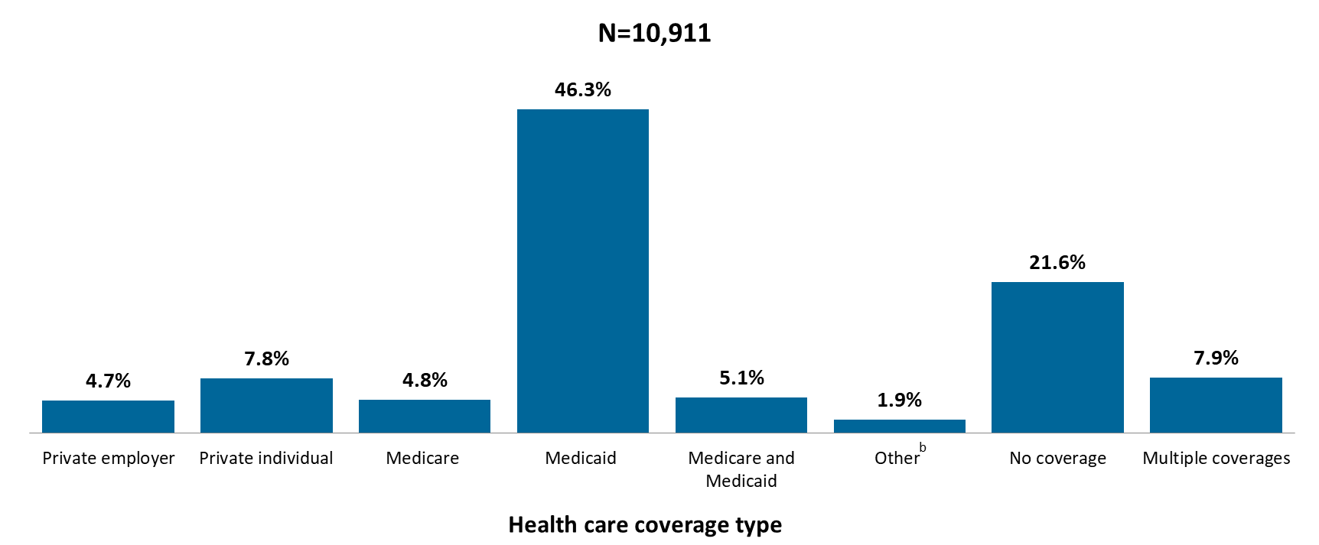
Transgender Women Served by the Ryan White HIV/AIDS Program, by Health Care Coverage, 2021—United States and 3 Territoriesª
ª Guam, Puerto Rico, and the U.S. Virgin Islands.
^{b} Other includes Veterans Administration, Indian Health Service, and other plan.
Notes:
Among the 10,911 transgender women served by RWHAP with reported health care coverage information, 78.4% were covered by some form of health care coverage during 2021: 46.3% were covered by Medicaid, 7.9% had multiple forms of coverage, 5.1% were covered by Medicare and Medicaid, and 4.8% were covered by Medicare. 21.6% of RWHAP transgender women had no health care coverage.
Multiple coverage includes any combination of coverage types except for the joint Medicaid and Medicare category, which is displayed separately.
The three territories are Guam, Puerto Rico, and the U.S. Virgin Islands.

Slide 10
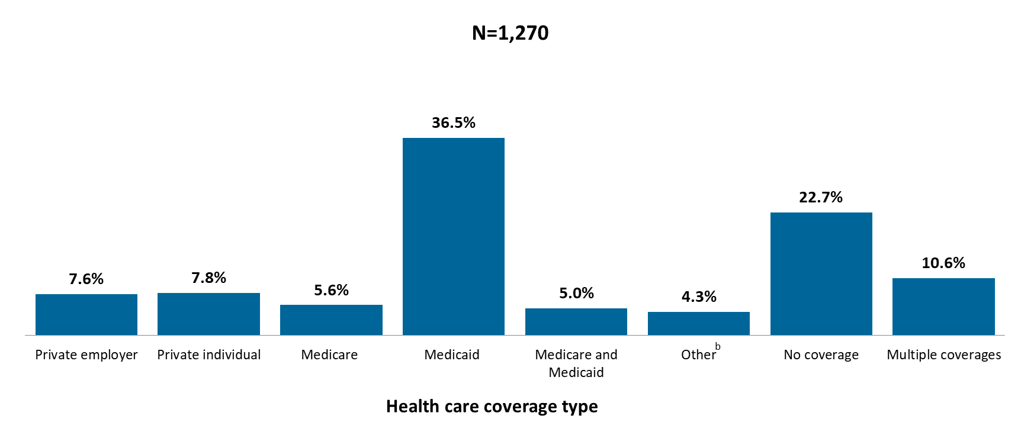
Transgender Men Served by the Ryan White HIV/AIDS Program, by Health Care Coverage, 2021—United States and 3 Territoriesª
ª Guam, Puerto Rico, and the U.S. Virgin Islands.
^{b} Other includes Veterans Administration, Indian Health Service, and other plan.
Notes:
Among the 1,270 transgender men served by RWHAP with reported health care coverage information, 77.3% were covered by some form of health care coverage during 2021: 36.5% were covered by Medicaid, 10.6% had multiple forms of coverage, 5.6% were covered by Medicare, and 5.0% were covered by Medicare and Medicaid. 22.7% of RWHAP transgender men had no coverage.
Multiple coverage includes any combination of coverage types except for the joint Medicaid and Medicare category, which is displayed separately.
The three territories are Guam, Puerto Rico, and the U.S. Virgin Islands.

Slide 11
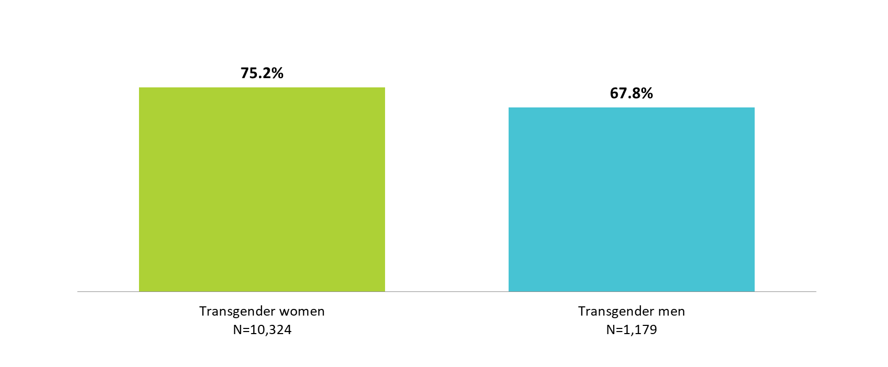
Transgender Clients Served by the Ryan White HIV/AIDS Program Living ≤100% of the Federal Poverty Level, by Gender Identity, 2021—United States and 3 Territoriesª
N represents the total number of clients in the specific subpopulation
Clients with other gender identities are not presented due to small numbers.
ª Guam, Puerto Rico, and the U.S. Virgin Islands.
Notes:
In 2021, of the 10,324 transgender women served by the RWHAP with income information, 75.2% were living at or below 100% of the federal poverty level (FPL). Among the 1,179 transgender men served by the RWHAP with income information, 67.8% were living at or below 100% FPL.
The three territories are Guam, Puerto Rico, and the U.S. Virgin Islands.

Slide 12
Viral Suppression
Transgender Clients

Slide 13
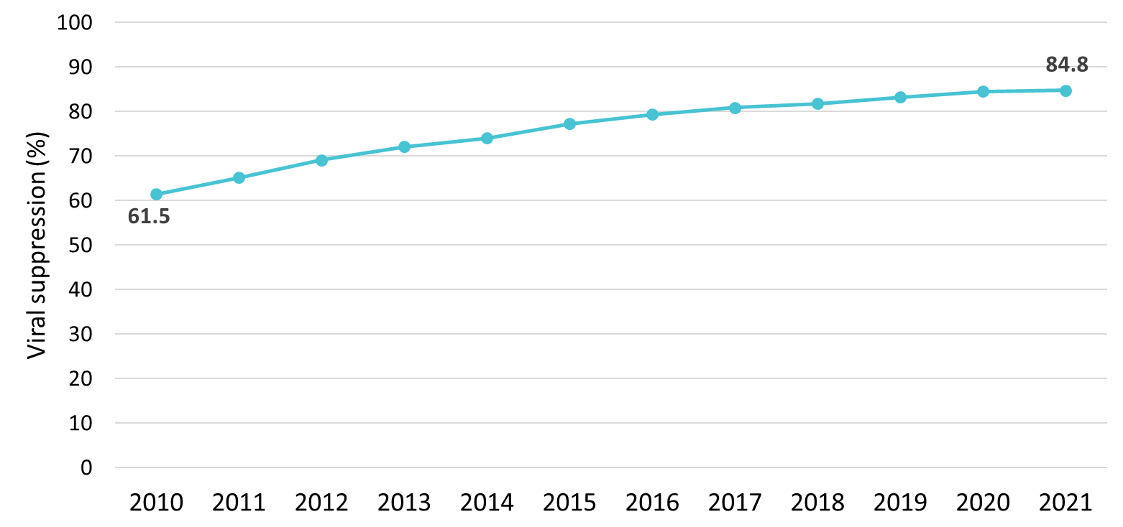
Viral Suppression among Transgender Clients Served by the Ryan White HIV/AIDS Program, 2010–2021—United States and 3 Territoriesª
Viral suppression: ≥1 OAHS visit during the calendar year and ≥1 viral load reported, with the last viral load result <200 copies/mL.
ª Guam, Puerto Rico, and the U.S. Virgin Islands.
Notes:
Viral suppression has increased steadily over time among transgender clients, from 61.5% in 2010 to 84.8% in 2021. Comparatively, the overall RWHAP population viral suppression in 2021 was 89.7%.
Viral suppression is defined as ≥1 outpatient/ambulatory health services visit during the calendar year and ≥1 viral load reported, with the last viral load result <200 copies/mL.
The three territories include Guam, Puerto Rico, and the U.S. Virgin Islands.

Slide 14
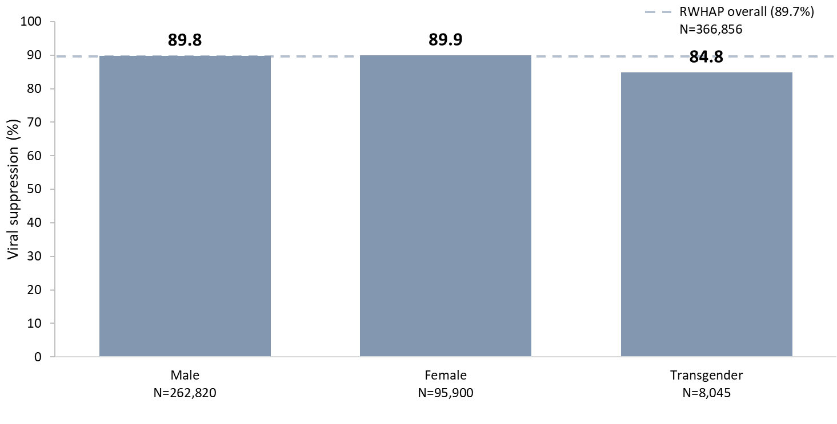
Viral Suppression among Clients Served by the Ryan White HIV/AIDS Program, by Gender, 2021—United States and 3 Territoriesª
N represents the total number of clients in the specific population.
Viral suppression: ≥1 OAHS visit during the calendar year and ≥1 viral load reported, with the last viral load result <200 copies/mL.
ª Guam, Puerto Rico, and the U.S. Virgin Islands.
Notes:
In 2021, viral suppression varied by gender; 84.8% of transgender clients achieved viral suppression, compared to 89.9% of female clients and 89.8% of male clients.
N represents the total number of clients in the specific subpopulation.
Viral suppression is defined as ≥1 outpatient/ambulatory health services visit during the calendar year and ≥1 viral load reported, with the last viral load result <200 copies/mL.
The three territories include Guam, Puerto Rico, and the U.S. Virgin Islands.

Slide 15
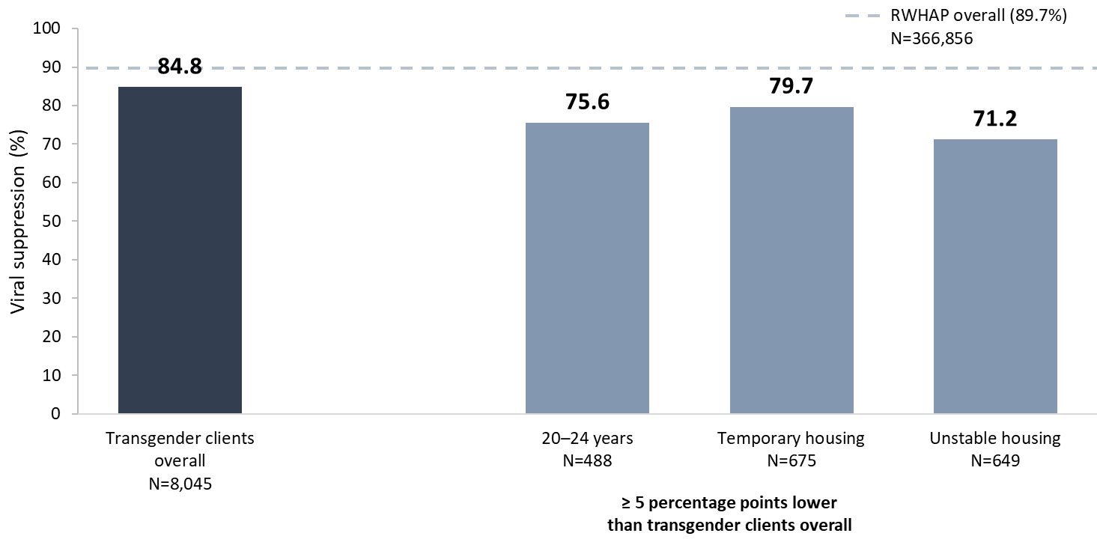
Viral Suppression among Transgender Adults and Adolescents Served by the Ryan White HIV/AIDS Program, 2021—United States and 3 Territoriesª
N represents the total number of clients in the specific population.
Includes transgender clients aged 15 years and older.
Viral suppression: ≥1 OAHS visit during the calendar year and ≥1 viral load reported, with the last viral load result <200 copies/mL.
ª Guam, Puerto Rico, and the U.S. Virgin Islands.
Notes:
In 2021, among transgender clients, viral suppression (84.8%) was lower than the national RWHAP average (89.7%) – indicated by the dashed grey line.
Viral suppression was lowest among transgender clients aged 20–24 years (75.6%); and those with temporary (79.7%) and unstable (71.2%) housing.
N represents the total number of clients in the specific subpopulation.
Viral suppression is defined as ≥1 outpatient/ambulatory health services visit during the calendar year and ≥1 viral load reported, with the last viral load result <200 copies/mL.
The three territories include Guam, Puerto Rico, and the U.S. Virgin Islands.

Slide 16
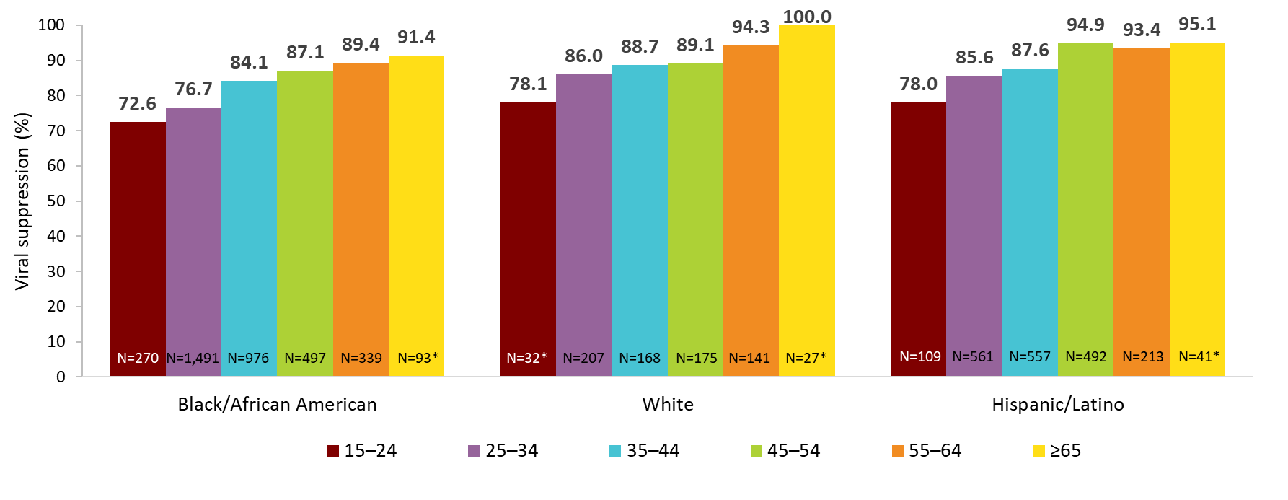
Viral Suppression Among Transgender Women Served by the Ryan White HIV/AIDS Program, by Race/Ethnicity and Age Group, 2021—United States and 3 Territoriesª
* N represents the total number of clients in the specific population. Use caution when interpreting percentages based on denominators less than 100.
Hispanics/Latinos can be of any race.
Note. Data are included for transgender women aged 15 and older.
Viral suppression: ≥1 OAHS visit during the calendar year and ≥1 viral load reported, with the last viral load result <200 copies/mL.
ª Guam, Puerto Rico, and the U.S. Virgin Islands.
Notes:
This slide shows viral suppression for Black/African American, White, and Hispanic/Latino transgender women clients in 2021 by age group. Overall, Black/African American transgender women clients had lower viral suppression compared to their White and Hispanic/Latino counterparts of the same age group, particularly among clients aged 25–34 and 35–44 years.
N represents the total number of clients in the specific subpopulation. Caution should be used when interpreting percentages based on denominators less than 100.
Viral suppression is defined as ≥1 outpatient/ambulatory health services visit during the calendar year and ≥1 viral load reported, with the last viral load result <200 copies/mL.
The three territories include Guam, Puerto Rico, and the U.S. Virgin Islands.

Slide 17
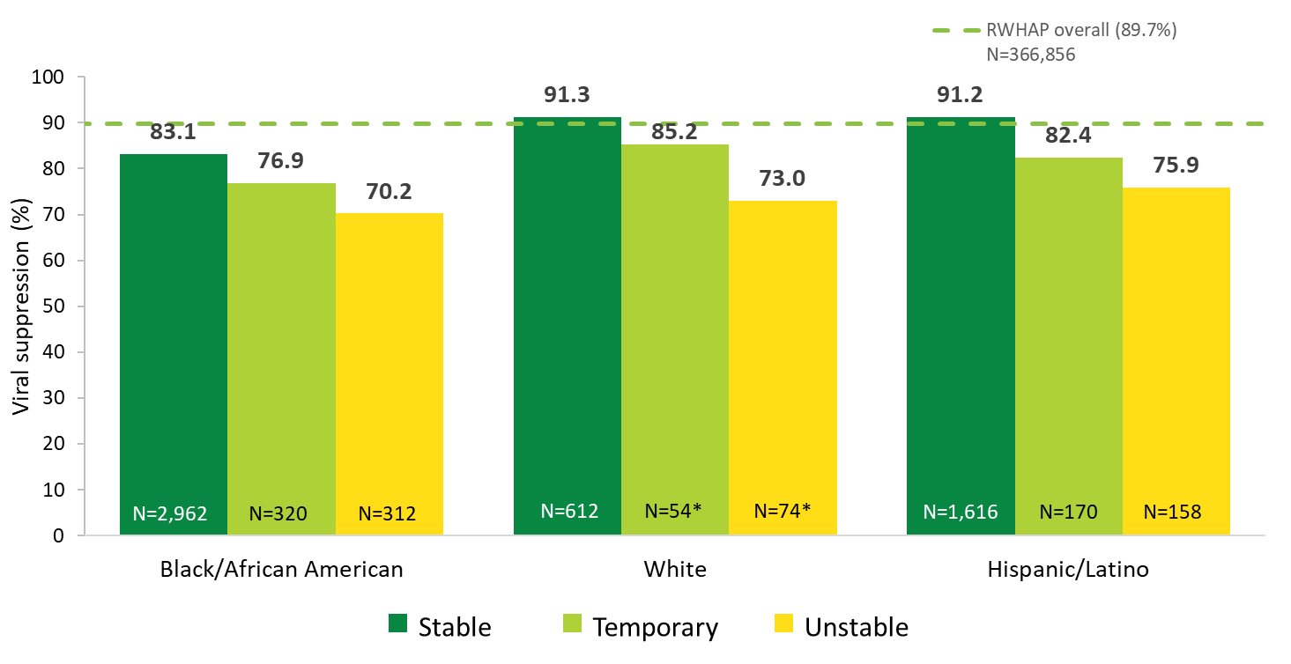
Viral Suppression Among Transgender Women Served by the Ryan White HIV/AIDS Program, by Race/Ethnicity and Housing Status, 2021—United States and 3 Territoriesª
* N represents the total number of clients in the specific population. Use caution when interpreting percentages based on denominators less than 100.
Hispanics/Latinos can be of any race.
Note. Data are included for MSM aged 13 and older.
Viral suppression: ≥1 OAHS visit during the calendar year and ≥1 viral load reported, with the last viral load result <200 copies/mL.
ª Guam, Puerto Rico, and the U.S. Virgin Islands.
Notes:
This slide shows viral suppression for Black/African American, White, and Hispanic/Latino transgender women clients in 2021, by housing status. Among clients with unstable housing, viral suppression was substantially lower than those with stable housing for Black/African American, White, and Hispanic/Latino clients. However, for all housing statuses, viral suppression for Black/African American transgender women was lowest compared to Whites and Hispanics/Latinos.
N represents the total number of clients in the specific subpopulation. Caution should be used when interpreting percentages based on denominators less than 100.
Viral suppression is defined as ≥1 outpatient/ambulatory health services visit during the calendar year and ≥1 viral load reported, with the last viral load result <200 copies/mL.
The three territories include Guam, Puerto Rico, and the U.S. Virgin Islands.

Slide 18
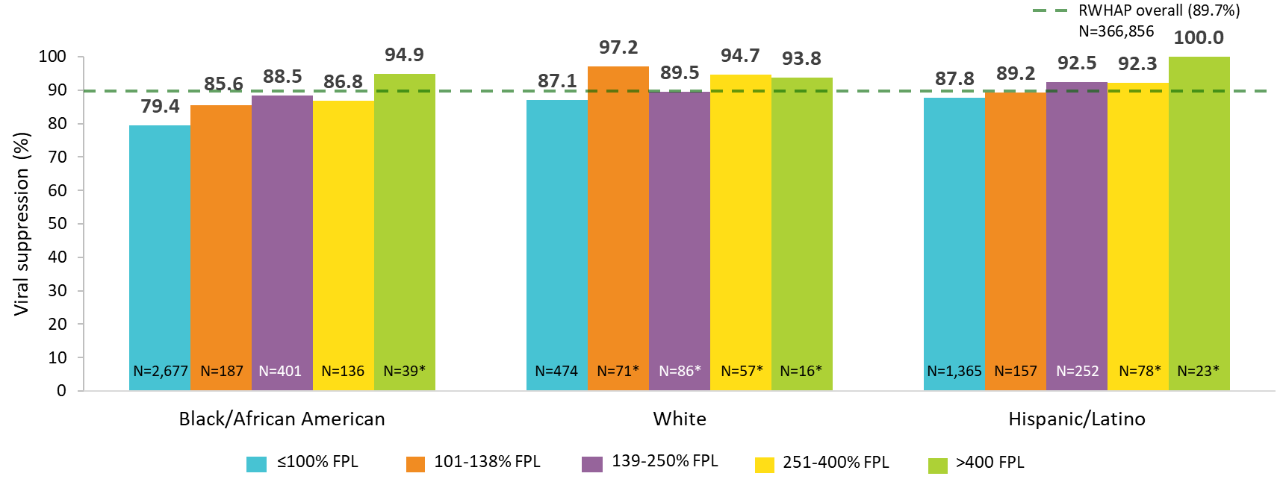
Viral Suppression Among Transgender Women Served by the Ryan White HIV/AIDS Program, by Race/Ethnicity and Federal Poverty Level (FPL), 2021—United States and 3 Territoriesª
*N represents the total number of clients in the specific population. Use caution when interpreting percentages based on denominators less than 100.
Hispanics/Latinos can be of any race.
Viral suppression: ≥1 OAHS visit during the calendar year and ≥1 viral load reported, with the last viral load result <200 copies/mL.
ª Guam, Puerto Rico, and the U.S. Virgin Islands.
Notes:
This slide shows viral suppression by federal poverty level (FPL) among transgender women clients in 2021, for Black/African American, White, and Hispanic/Latino clients. Viral suppression for Black/African American transgender women was lower than the national RWHAP average (89.7%) – indicated by the dashed green line – for all poverty levels except the >400% level. Notably, viral suppression for Black/African American transgender clients living at or below 100% FPL was slightly more than 10 percentage points lower than the national RWHAP average.
N represents the total number of clients in the specific subpopulation. Caution should be used when interpreting percentages based on denominators less than 100.
Viral suppression is defined as ≥1 outpatient/ambulatory health services visit during the calendar year and ≥1 viral load reported, with the last viral load result <200 copies/mL.
The three territories include Guam, Puerto Rico, and the U.S. Virgin Islands.

